Slide 1
Logistics
No Class next Thursday
I’m giving a talk that conflicts with our class time
Use this time to finalize your project milestone 1!
Project milestone 1
Due Oct 14 (Next Friday)
Initial literature survey (know what other works are out there)
A plan on what you want to do for the remaining of the semester
Formalize your research question and approaches, e.g.,
Theory/simulation project: formalize your models
Data-analysis project: figure out where and how to get data and what you plan to do with it
Experiment/application project: have a prototype design and an evaluation plan
Include a timeline (weekly or biweekly) on what you plan to do
Nov 1: Midterm project pitch and discussion
Nov 4: Milestone 2 report

Slide 2
Logistics
Assignment 3:
Due: Oct 13 (Wednesday)
Extended to Oct 17 (Monday) in observance of fall break
Office hours
I have blocked time till 6pm after each lecture
Will stay for questions and then go back to my office (McKelvey 2010A)

Slide 3
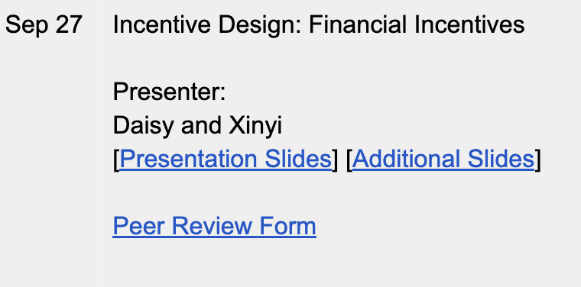
Logistics: Peer Reviews
For each of the student presentations, please fill in the peer review form.
The link to the form will be posted on the course website before the lecture
Please try to submit the form by 6pm.
Please be polite. List positives and points to improve. Be constructive.
The feedback will be anonymous to the presenters but not anonymous to CJ.

Slide 4
Switch Over to Presenters

Slide 5
Lecture 11 Additional Discussion for DARPA Network Challenge: Incentives and Learning in Networks
Instructor: Chien-Ju (CJ) Ho

Slide 6
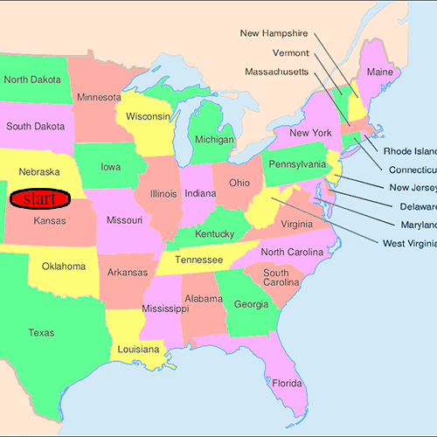
The Small-World Experiment [Stanley Milgram, 1967]
How many hops does it take to deliver a mail from a person in Nebraska/Kansas to a person in Massachusetts?
A person can only pass the mail to someone she/he knows in a first-name basis.
Average: Around 5.5~6 hops
Six degrees of separation
There are criticisms on the methodology, but the results are still very impressive
[The figure is from Wikipedia]

Slide 7
Small-World Networks [Watts and Strogatz, Nature 1998]
Two characteristics
People form “cliques” (my friends are usually my friends’ friends)
There are some random links
“One of the models” that explain the small world phenomenon

Slide 8
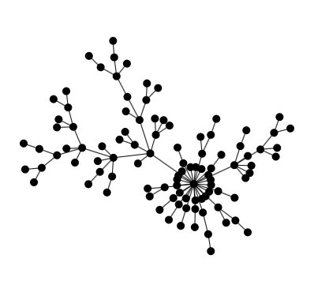
Another Social Network Model
Preferential Attachments (Barabási–Albert Model)
People join the network one by one
Attach (form edges) to existing members
Attach probability is proportional to # edges
Explains the rich-gets-richer effect

Slide 9
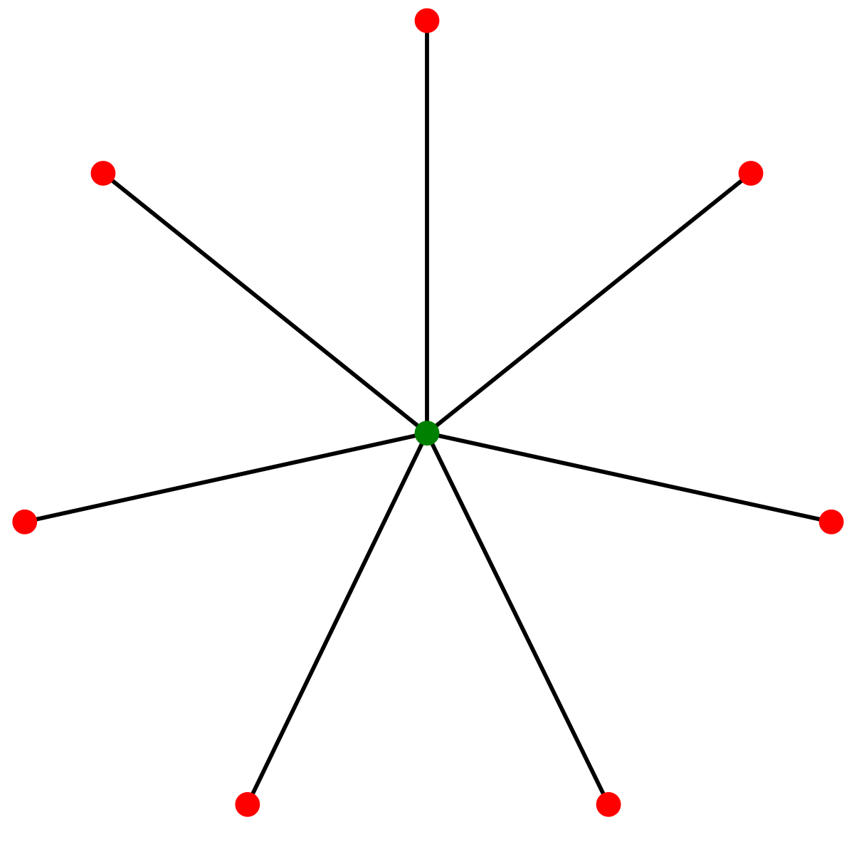
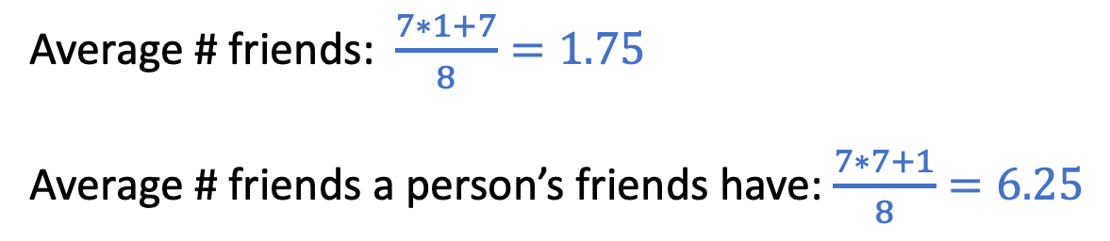
Friendship Paradox [Scott L. Feld. 1991]
On average, do your friends have more friends than you have?
Yes, if we take the average over everyone in the network.
Local observations could be distorted by the network structure
One’s friends are happier, wealthier, more popular…
Average # friends: $\frac{7∗1+7}{8}=1.75$
Average # friends a person’s friends have: $\frac{7∗7+1}{8}=6.25$
Notes:
Networks are not random connections between people What are the effects?

Slide 10
Utilizing the Power of Networks
Given we can reach most people in a small number of hops, can we utilize the people in networks to help with tasks.
Not that trivial
A replication of the small world experiment using emails has faced a high-level of drop-out rate since people are not motivated in attending.
Need proper incentives:
See more in the seminal paper of query incentive networks

Slide 11

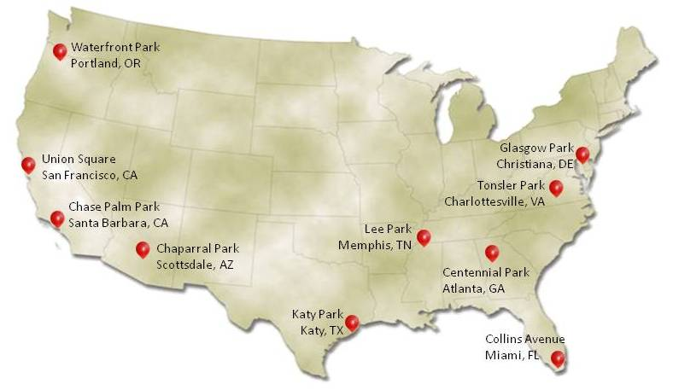

Query Incentive Networks [Kleinberg and Raghavan, 2005]
Formalize the theoretical discussion on incentives in networks
Successful example: DARPA network challenge

Slide 12

Generalize the Results from DARPA Network Challenge
DARPA shredder challenge, 2011
Goal: Piece together the information in shredded paper
First team to complete 5 puzzles win $50,000
Duration: October 27, 2011 to December 4, 2011

Slide 13
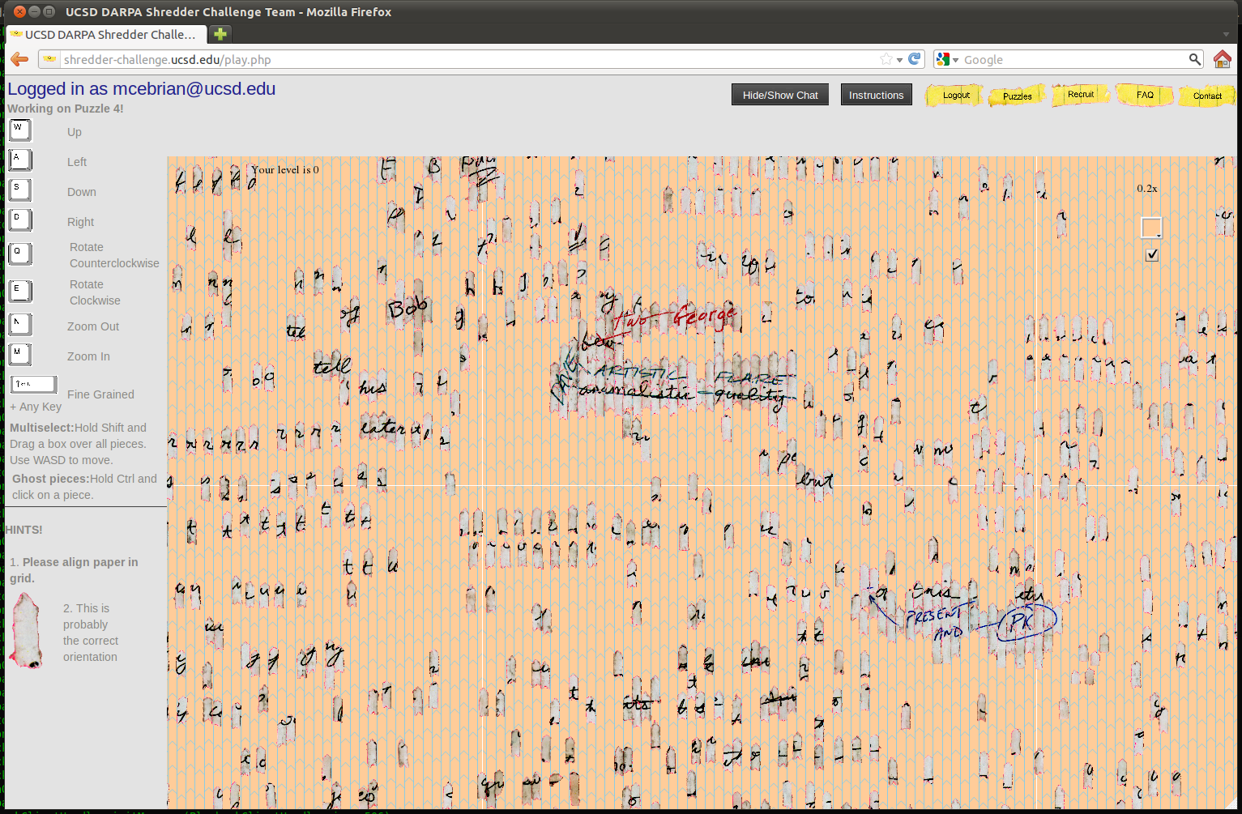
Generalize the Results from DARPA Network Challenge
UCSD team tried the same method as MIT team did in network challenge
Solved 3 (out of 5) puzzles in 5 days
No progress after that
Too many sabotage attempts to ruin their results
Designing mechanisms robust to adversarial attacks is important but non-trivial
“However, the crowd was hopeless against a determined attacker. Before the first attack, our progress on the fourth puzzle had combined 39,299 moves by 342 users over more than 38 hours. Destroying all this progress required just 416 moves by one attacker in about an hour.”
“creation took 100 times as many moves and about 40 times longer than destruction.”
How Crowdsourcing Turned On Me. Iyad Rahwan.

Slide 14
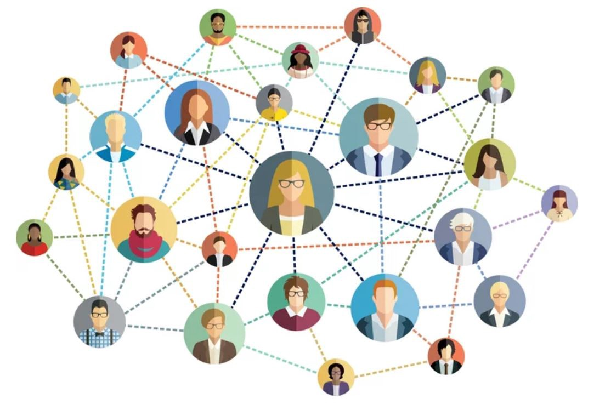
Utilizing the Power of Networks
Influence maximization [Who should we start to ask questions?]
You can send products to K people to try on
Assume people who try the product will tell their neighbors with some probability
Who should you choose to send the products maximize the expected number of people knowing your product?
Generally a NP-hard question.
There exists efficient approximation algorithms,
if you know the network structure.
What if you don’t know the network structure?
Learning and sampling

Slide 15
Utilizing the Power of Networks
AI for social good: Taking interventions to prevent HIV for homelessness youth [Wilder et al. 2021]
Procedure
Recruit “peer leaders” in drop-in centers
Train the leaders and have them help disseminate the information
Adapt techniques from influence maximization to maximize the information spread
Help reduce 31% chance of risky behavior

Slide 16
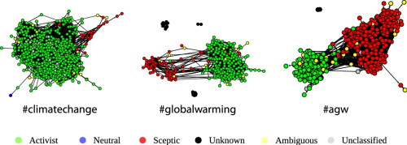
Other Challenges/Opportunities of Networks
Network could create biases in data collection [Saveski et al. 2017]
Opinion formation: Human opinions might be influenced by networks
Neighbors might have similar opinions
Break the common “independence” assumption
[Williams et al. 2015]

Slide 17
https://www.cs.cornell.edu/home/kleinber/networks-book/

Slide 18
Proper Scoring Rules

Slide 19
Incentivizing Truthful Reports About Probabilities
Example scenarios:
Ask a weather forecaster: will it rain tomorrow?
Ask a political researcher: will Trump win 2020 election?
Ask a Microsoft employer: will the new version of Office be shipped on time?
Want to obtain forecasts about future events
How do we make sure we obtain truthful reports?

Slide 20
Incentivizing Truthful Reports
Setting
Consider a rational agent with linear utility for cash
Suppose there are $n$ mutually exclusive and exhaustive states of the world $Ω=\left\{w_{1},w_{2},…,w_{n}\right\}$ (e.g., Sun, Rain, Snow)
$p_{i}$ is the subjective belief of the agent that state $w_{i}$ will occur
Question
How do we motivate this agent to tell us her beliefs about the likelihood of each state?

Slide 21
Scoring Rules
A scoring rule rewards an agent $S\left(\vec{r},w\right)$ when her reported distribution is$\vec{r}$ and the realized outcome is $w$

Slide 22
Scoring Rules
Let’s consider a linear scoring rule
$S\left(\vec{r},w_{i}\right)=r_{i}$
If a risk-neutral agent believes the probability for Rain and Sun are $\vec{p}=(0.7, 0.3)$
What report should the agent provide?

Slide 23
Scoring Rules
A scoring rule rewards an agent $S\left(\vec{r},w\right)$ when her reported distribution is$\vec{r}$ and the realized outcome is $w$
A scoring rule is called proper if the agent maximizes her utility by providing truthful report
$$\vec{p}=\text{argma}{\text{x}}_{\vec{r}}\sum_{i=1}^{n}{p_{i}S(\vec{r},w_{i})}$$
A scoring rule is strictly proper if honestly reporting is the unique maximizer.

Slide 24
Examples of Strictly Proper Scoring Rules
Quadratic scoring rule (Brier score):
$$S\left(\vec{r},w_{i}\right)=r_{i}−\frac{1}{2}\sum_{j}{r_{j}^{2}}$$
We can verify this by taking the gradient of the expected payoff
Affine transformation of the proper scoring rule is still proper.

Slide 25
Examples of Strictly Proper Scoring Rules
Logarithmic scoring rule:
$$S\left(\vec{r},w_{i}\right)=\log{r_{i}}$$
We can verify this by taking a gradient of the expected payoff
In logarithmic scoring rule, the score for outcome $w_{i}$ only depends on the report $r_{i}$ and not $r_{j}$ for $j≠i$

Slide 26
More examples?
How do we construct a strictly proper scoring rule?
How many strictly proper scoring rules are there?

Slide 27
Characterization of Proper Scoring Rules
Connections between convex functions and proper scoring rules.
A scoring rule $S(\vec{r},w_{i})$ is (strictly) proper if and only if
$$S\left(\vec{r},w_{i}\right)=G\left(\vec{r}\right)−\sum_{j≠i}{G_{j}^{′}\left(\vec{r}\right)p_{j}+G_{i}^{′}(\vec{r})}$$
where $G(\vec{r})$ is a (strictly) convex function, $G′(\vec{r})$ is a subgradient of $G$ at $\vec{r}$, and $G_{i}^{′}(\vec{r})$ is its $i$-th component.
Section 3.1 of Strictly Proper Scoring Rules, Prediction, and Estimation by Gneiting and Raftery.

Slide 28
Connection to Prediction Market

Slide 29
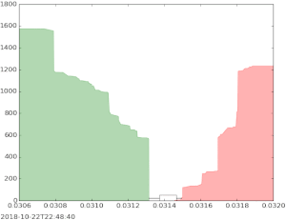
Designing Automatic Market Makers
Traditional market mechanisms might not work when the market is thin

Slide 30
Designing Automatic Market Makers
Goal of the market maker
Incentivize multiple agents to share their beliefs, and find a way to aggregate these beliefs into a unified prediction
1. Could use one scoring rule per agent, but not clear how to aggregate
2. Market itself is an aggregation mechanism (use final price as the prediction). However, standard stock-market-style trading might encounter issues for less popular predictions (market is too thin).

Slide 31
Market Scoring Rules
See Hanson’s papers in the optional readings of the Prediction Market lecture
Intuitions: a “sequentially shared scoring rule”
An automatic market maker
Market maintains a vector of predictions ${\vec{r}}^{(t)}$
If a trader changes the vector from ${\vec{r}}^{(t)}$ to ${\vec{r}}^{(t+1)}$ and the outcome is $w_{i}$, the trader obtains reward
$S\left({\vec{r}}^{\left(t+1\right)},w_{i}\right)−S\left({\vec{r}}^{\left(t\right)},w_{i}\right)$
Under some conditions:
Agents truthfully report their beliefs
The prediction will converge

